Slide 1
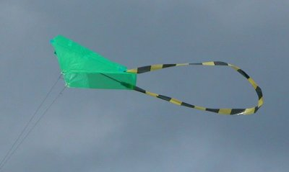
WHITE HORSE KITE FLYERS
HOW TO MAKE THE SLED

Slide 2
DISCLAIMER
PLEASE NOTE: -
THE DESIGN OF THIS SLED IS COPYRIGHT TO MR N.HARVEY OF WHKF.
THE AUTHOR, DESIGNER AND WHKF CAN ACCEPT NO RESPONSIBILITY FOR ACCIDENT OR INJURY CAUSED BY THE CONSTRUCTION OR FLYING OF THE KITE DESCRIBED IN THIS PRESENTATION.
WHKF CAN SUPPLY KITS FOR THIS KITE .
PLEASE CONTACT US FOR CURRENT PRICES

Slide 3
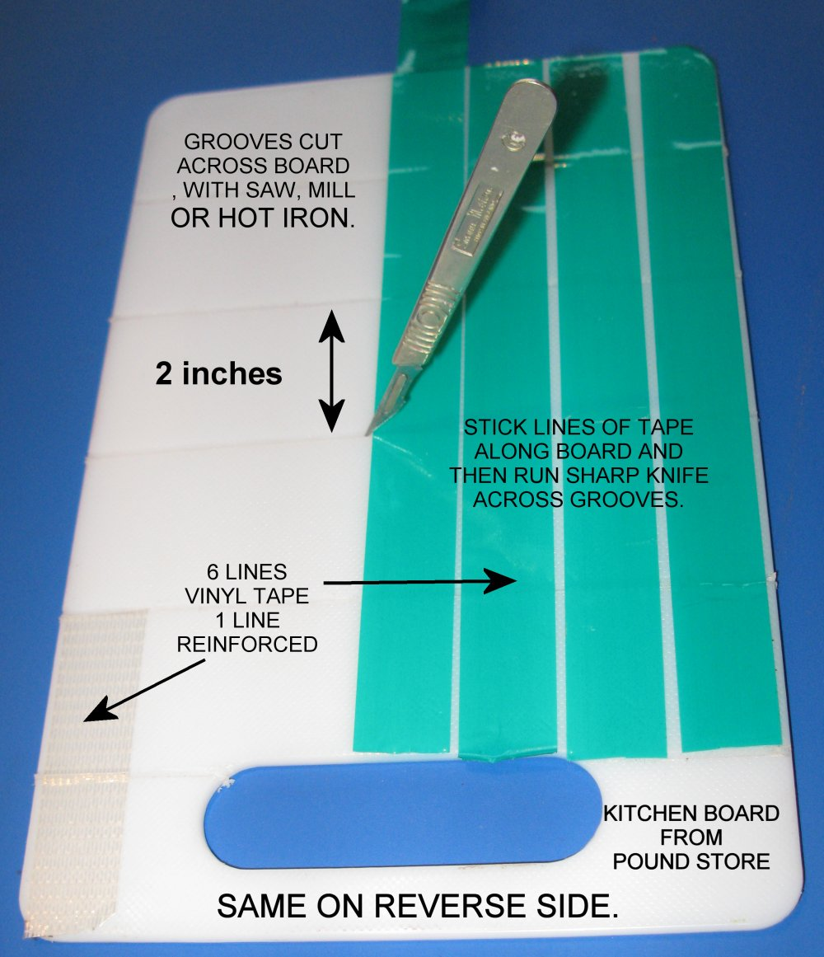
TOOLS REQUIRED
SCISSORS
5MM HOLE PUNCH
TAPE DISPENSER OR BOARDS
TO USE THE BOARDS, LAY THE TAPE
ALONG THE LENGTH AND RUN A
SHARP KNIFE ACROSS THE
GROOVES.

Slide 4
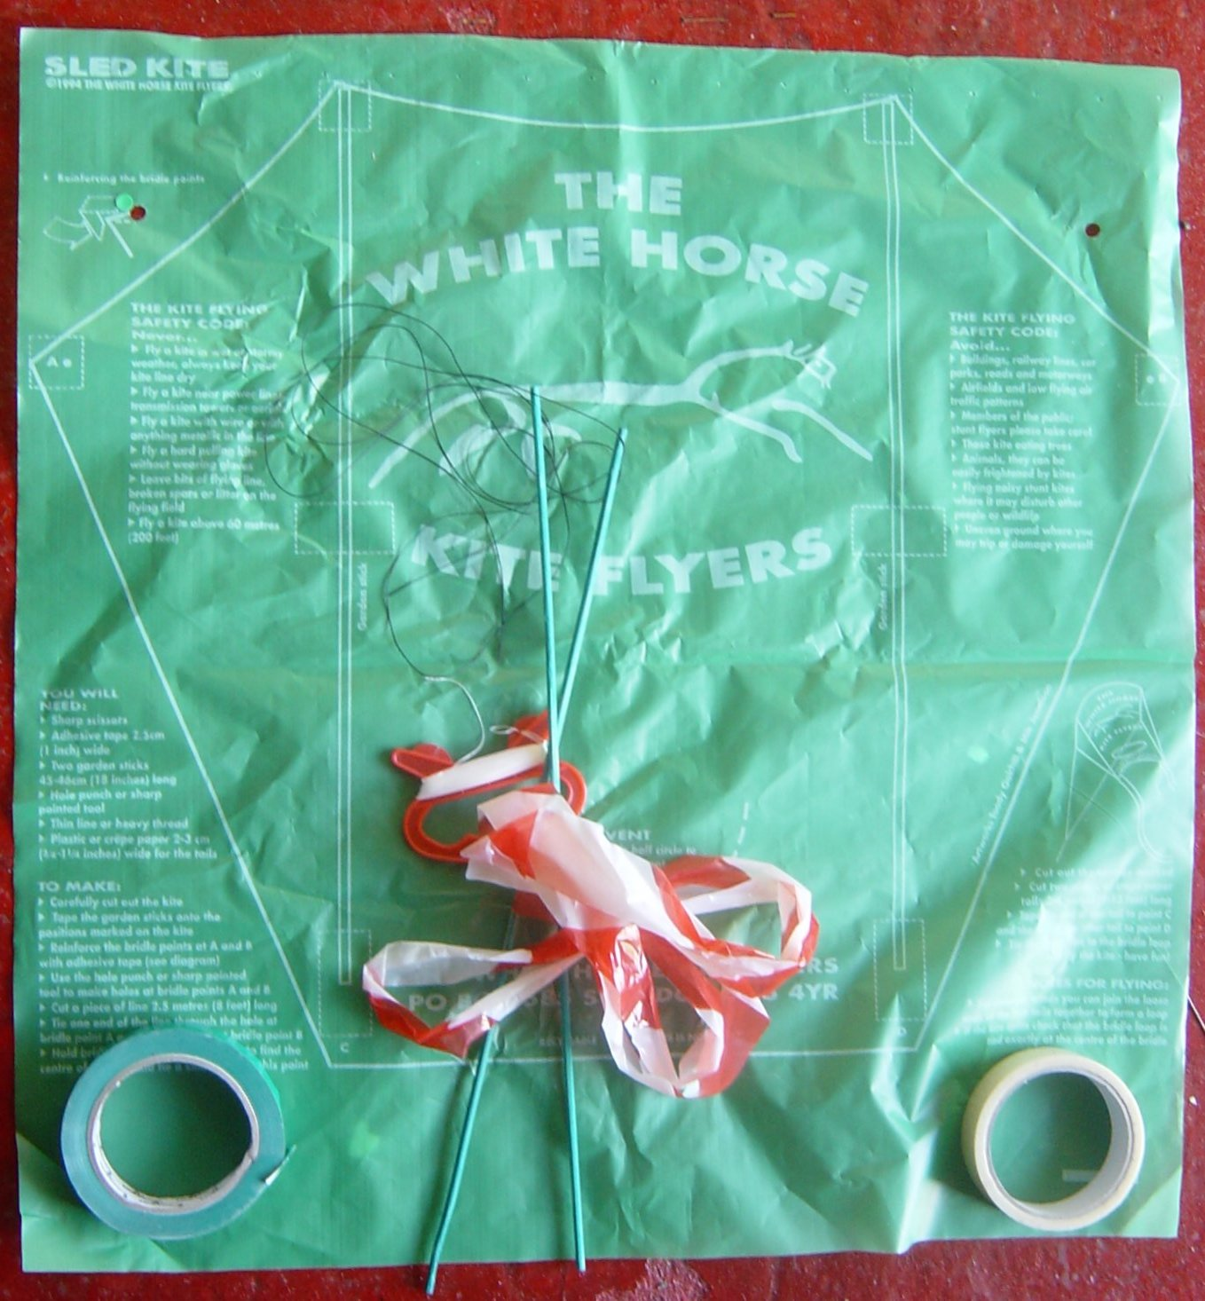
THE KIT
FULL INSTRUCTIONS ARE PRINTED AROUND THE KITE.
1 SKIN
2 STICKS
1 TAIL
1 BRIDLE
1 HANDLE WITH FLYING LINE
REINFORCING TAPE
VINYL TAPE

Slide 5
PREPARE THE SKIN 1
CUT OUT AROUND THE OUTSIDE SOLID LINE.
AND THE DOTTED SEMICIRCLE.

Slide 6
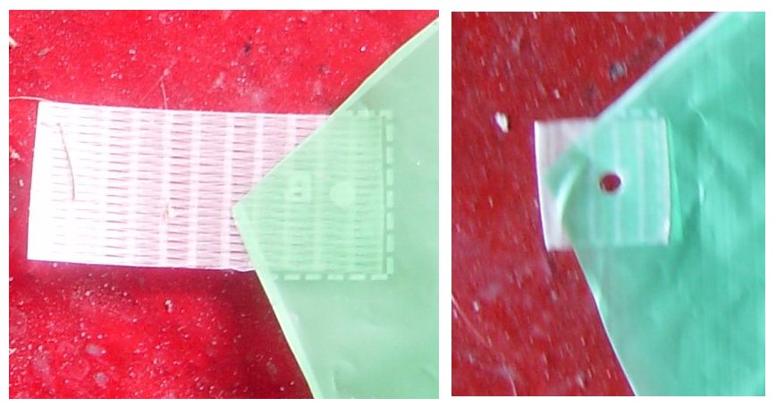
PREPARE THE SKIN 2
FOLD A 50MM PIECE OF REINFORCING TAPE OVER THE 2 BRIDLE CORNERS WHERE MARKED.
PUNCH A 5MM HOLE THROUGH THESE CORNERS. (Marked A & B) (PLACING A THIN PIECE OF CARD BEHIND THE KITE WILL MAKE IT EASIER TO CLEAR THE PUNCH. A LIGHT SPRAY OF WD40 ON THE PUNCH WILL ALSO HELP.)

Slide 7
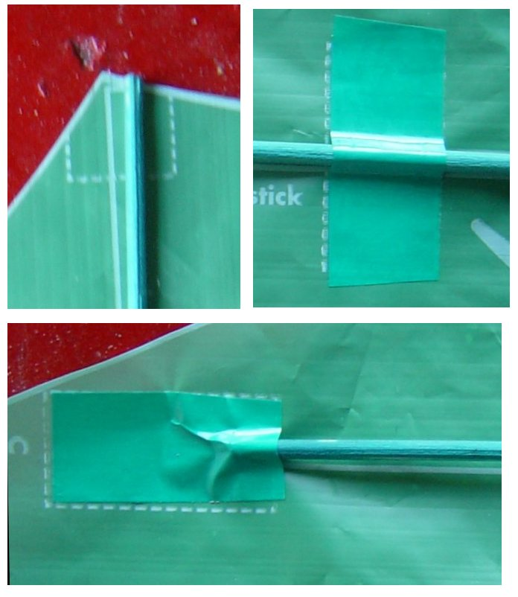
FIT THE STICKS
LAY THE SKIN FACE UP ON A FLAT SURFACE.
ALIGN THE STICKS WITH THE TOP OF THE SKIN.
FIX THE STICKS USING 50MM LENGTHS OF VINYL TAPE IN THE CENTRE AS INDICATED BY THE DOTTED LINES.
ADD FIXING TO THE BOTTOM OF THE STICKS BENDING THEM AS NECESSARY TO ALIGN WITH MARKINGS.

Slide 8
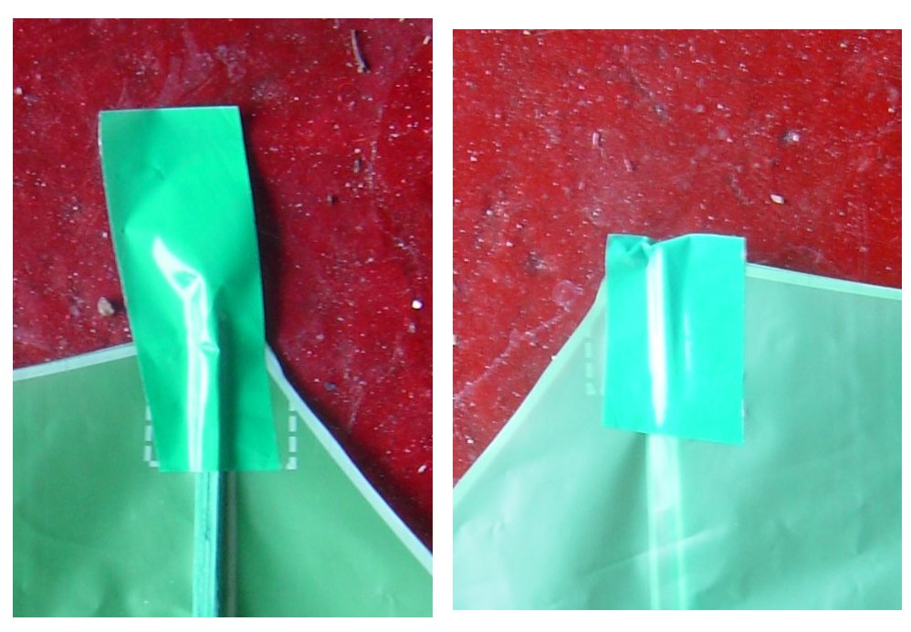
FIXING THE TOP
ADD A PIECE OF TAPE TO THE TOP STICK POINT AS INDICATED. THIS SHOULD BE ONLY HALF ON THE SKIN.
TURN THE SKIN OVER AND FOLD THE TAPE BACK.

Slide 9
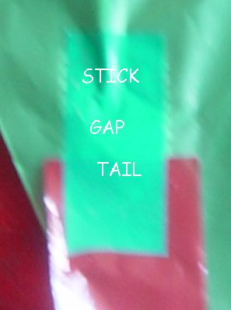
ADDING THE TAIL
AT THE BOTTOM OF THE SKIN PLACE ONE END OF THE TAIL, LEAVING A GAP BEFORE THE STICK.
FIX WITH TAPE OVER THE STICK, SKIN AND TAIL.
MAKE SURE THERE ARE NO TWISTS IN THE TAIL AND FIT THE OTHER END BELOW THE OTHER STICK

Slide 10
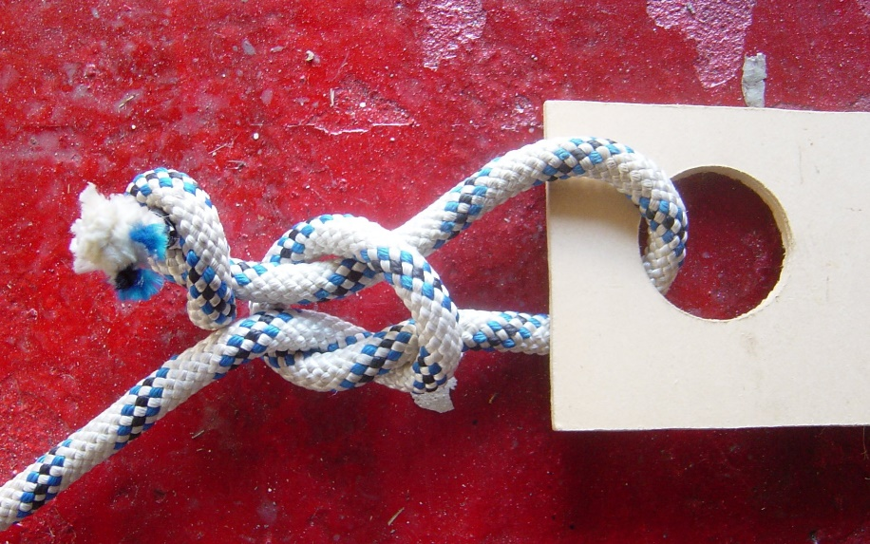
THE BRIDLE 1
PUT A SMALL STOPPER KNOT CLOSE TO ONE END OF THE BRIDLE LINE.
MAKE A SECOND KNOT FURTHER DOWN THE LINE BUT LEAVE IT OPEN.
PASS THE SMALL STOPPER KNOT THROUGH ONE OF THE REINFORCED CORNERS AND THEN BACK THROUGH THE OPEN KNOT.
TIGHTEN THE OPEN KNOT AND SLIDE IT TO THE STOPPER KNOT.
REPEAT FOR THE OTHER END.

Slide 11
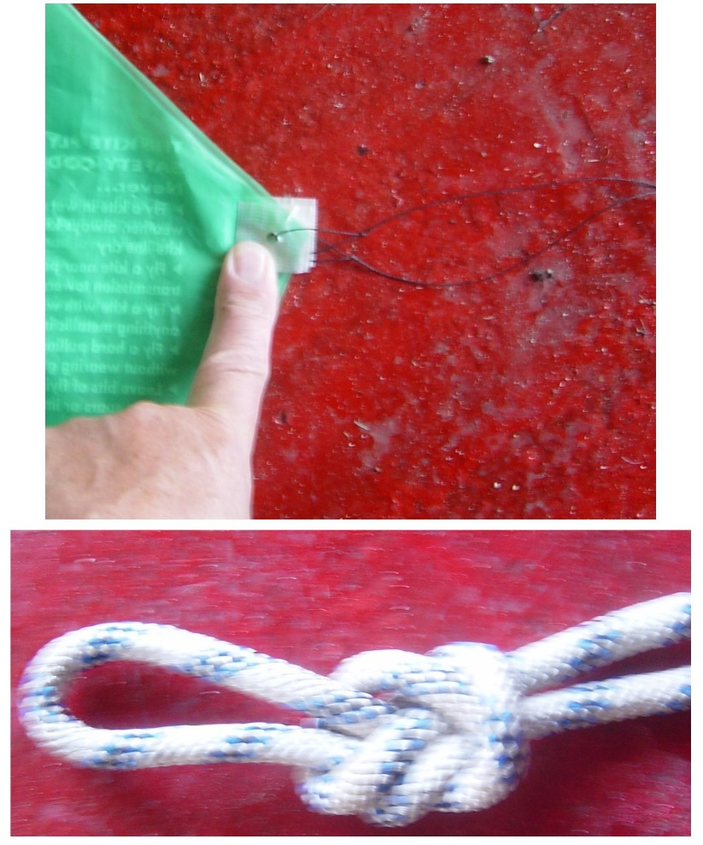
THE BRIDLE 2
FOLD THE SKIN IN HALF AND ALIGN THE BRIDLE POINTS CAREFULLY.
PULL OUT THE BRIDLE LINE TO FIND THE CENTRE AND TIE AN OVERHAND LOOP.
THIS IS CRIITICAL AS IF THE LOOP IS OFF CENTRE THE KITE WILL SPIN SIDEWAYS.

Slide 12
ATTACHING THE LINE 1
UNWIND A SHORT LENGTH OF LINE FROM THE HANDLE AND MAKE SURE THERE IS A LOOP IN IT.
IF NOT MAKE ONE USING AN OVERHAND LOOP AS SHOWN IN THE PREVIOUS SLIDE.

Slide 13
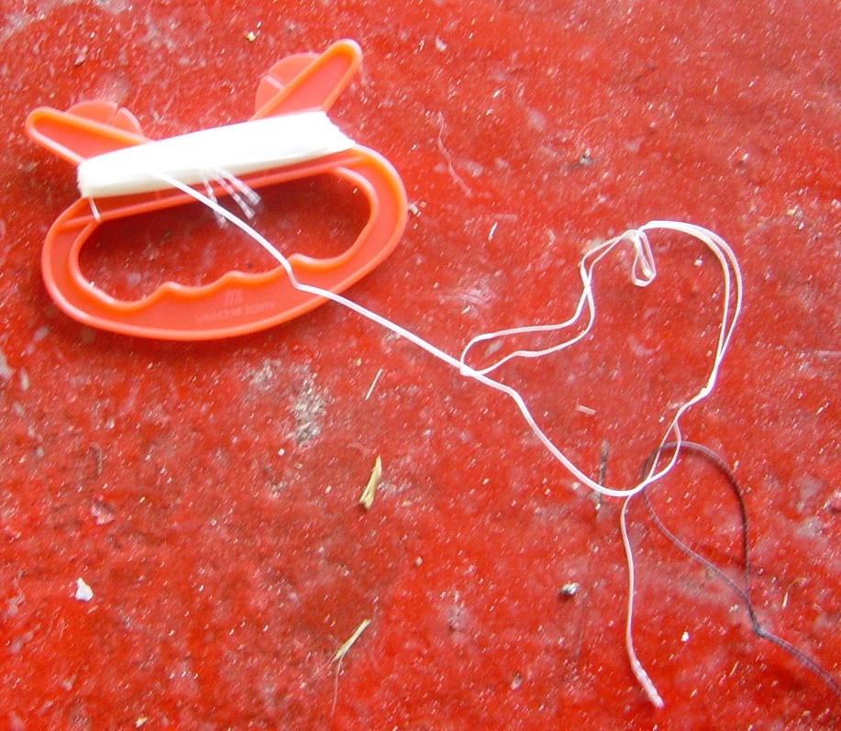
ATTACHING THE LINE 2
PASS THE LOOP IN THE LINE THROUGH THE LOOP IN THE BRIDLE.
PASS THE HANDLE BACK THROUGH ITS OWN LOOP.
PULL TIGHT.

Slide 14
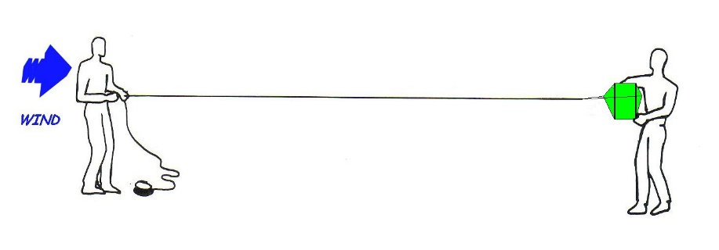
FLYING THE SLED
STAND WITH THE WIND BLOWING AGAINST YOUR BACK.
GET AN ASSISTANT TO HOLD THE KITE OUT WITH STICKS INSIDE AND FACING YOU.
UNREEL AS MUCH LINE AS SPACE PERMITS.
WHEN YOU ARE BOTH READY AND YOU CAN FEEL SOME BREEZE PULL GENTLY ON THE LINE AS YOUR ASSISTANT RELEASES THE KITE AND IT WILL RISE INTO THE SKY.

Slide 15
WARNINGS
Always fly safely
Always be considerate to other people using the same area whether it is noise or physical intrusion into their space.
Never fly at a height of more than 60 metres above ground level unless a CAA clearance is in force (as at kite festivals). If you don’t know what the clearance is ASK!
Never fly a kite in wet or stormy weather. Always try and keep your line dry.
Never fly a kite near power lines, transmission towers or aerials.
Never fly near Motorways, roads, car parks or railways.
Never fly near airfields. The maximum height limit in any area of restricted air space is 30 metres.
Never have any metal in the flying line and do not attach anything sharp to the line.
Always make sure that you use an adequate anchor for large kites and never leave them unattended.
Always wear strong gloves when flying large kites.
Always give priority to domestic animals particularly if they are showing signs of distress.
Always clear up after yourself, especially lines, tails and bits of plastic that could trap, choke or injure domestic animals.
Never fly near those kite-eating trees.
Finally remember…..your kites can get really quite lonely up high in the sky; just occasionally, look up and give them a SMILE. It will make you feel better too.

Slide 16
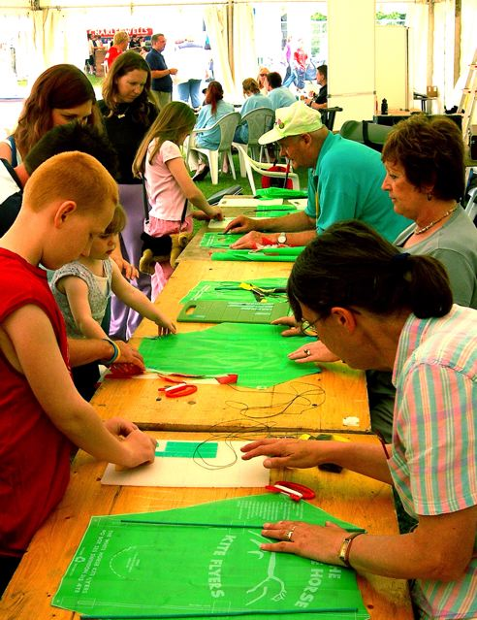
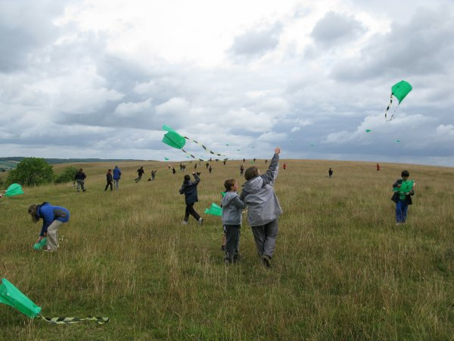
GO AND HAVE FUN

Slide 17
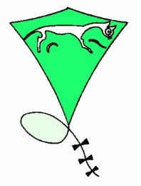
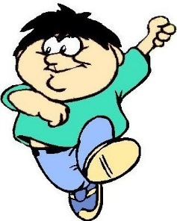
If you want to see more
Please come to
our monthly fly-in,
Second Sunday every month
at
Barbury Castle near Swindon
www.whkf.org.uk

Slide 18

PREPARED BY
ARTHUR DIBBLE
FOR WHITE HORSE KITE FLYERS
www.whkf.org.uk
JULY 2007

Slide 19
THE END

